Slide 1


Slide 2
TestNG Framework
TestNG is an open source automated TestNG framework. In TestNG, NG stands for "Next Generation".
TestNG is a very important framework when you are actually developing the framework from scratch level.
TestNG provides you full control over the test cases and the execution of the test cases. Due to this reason, TestNG is also known as a testing framework.
Cedric Beust is the developer of a TestNG framework.
If you want to run a test case A before that as a pre-request you need to run multiple test cases before you begin a test case A. You can set and map with the help of TestNG so that pre-request test cases run first and then only it will trigger a test case A. In such way, you can control the test cases.
TestNG framework came after Junit, and TestNG framework adds more powerful functionality and easier to use.

Slide 3
Advantages of TestNG over Junit
In TestNG, annotations are easier to understand than Junit.
It produces the HTML, emailable reports for implementation.
In TestNG, there is no constraint available such as @beforeclass and @afterclass which is present in Junit.
TestNG enables you to group the test cases easily which is not possible in JUnit.
TestNG supports three additional levels such as @Before/After suite, @Before/AfterTest, and Before/AfterGroup.
TestNG does not extend any class. TestNG framework allows you to define the test cases where each test case is independent of other test cases.
In TestNG we can prioritize the test case which is not possible in Junit.

Slide 4
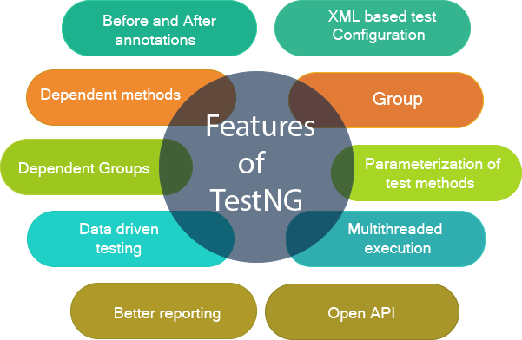

Slide 5
Installation of TestNG with Eclipse: We can install TestNG with Eclipse in 2 different ways.
1. Directly from Official website of TestNG
2. From Eclipse Market Place

Slide 6
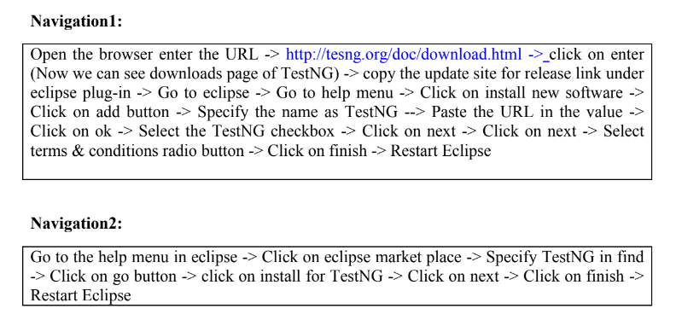

Slide 7
List of Annotations in TestNG
Annotation: Annotations are nothing but predefine classes which contains reusable code.
Every annotations starts with ‘@’ symbol
@BeforeSuite
@AfterSuite
@BeforeTest
@AfterTest
@BeforeClass
@AfterClass
@BeforeMethod
@AfterMethod
@Test
@Ignore

Slide 8
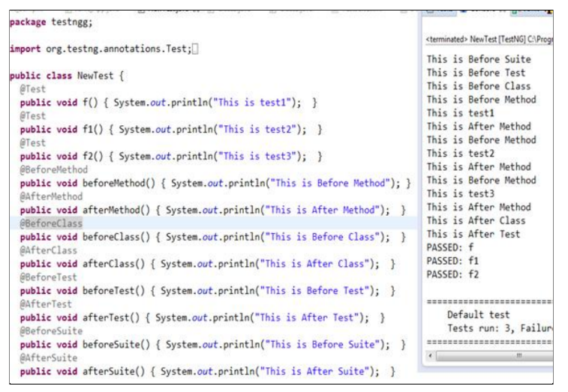

Slide 9
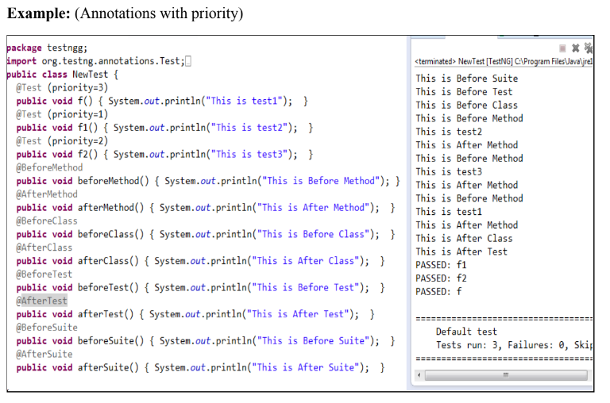

Slide 10
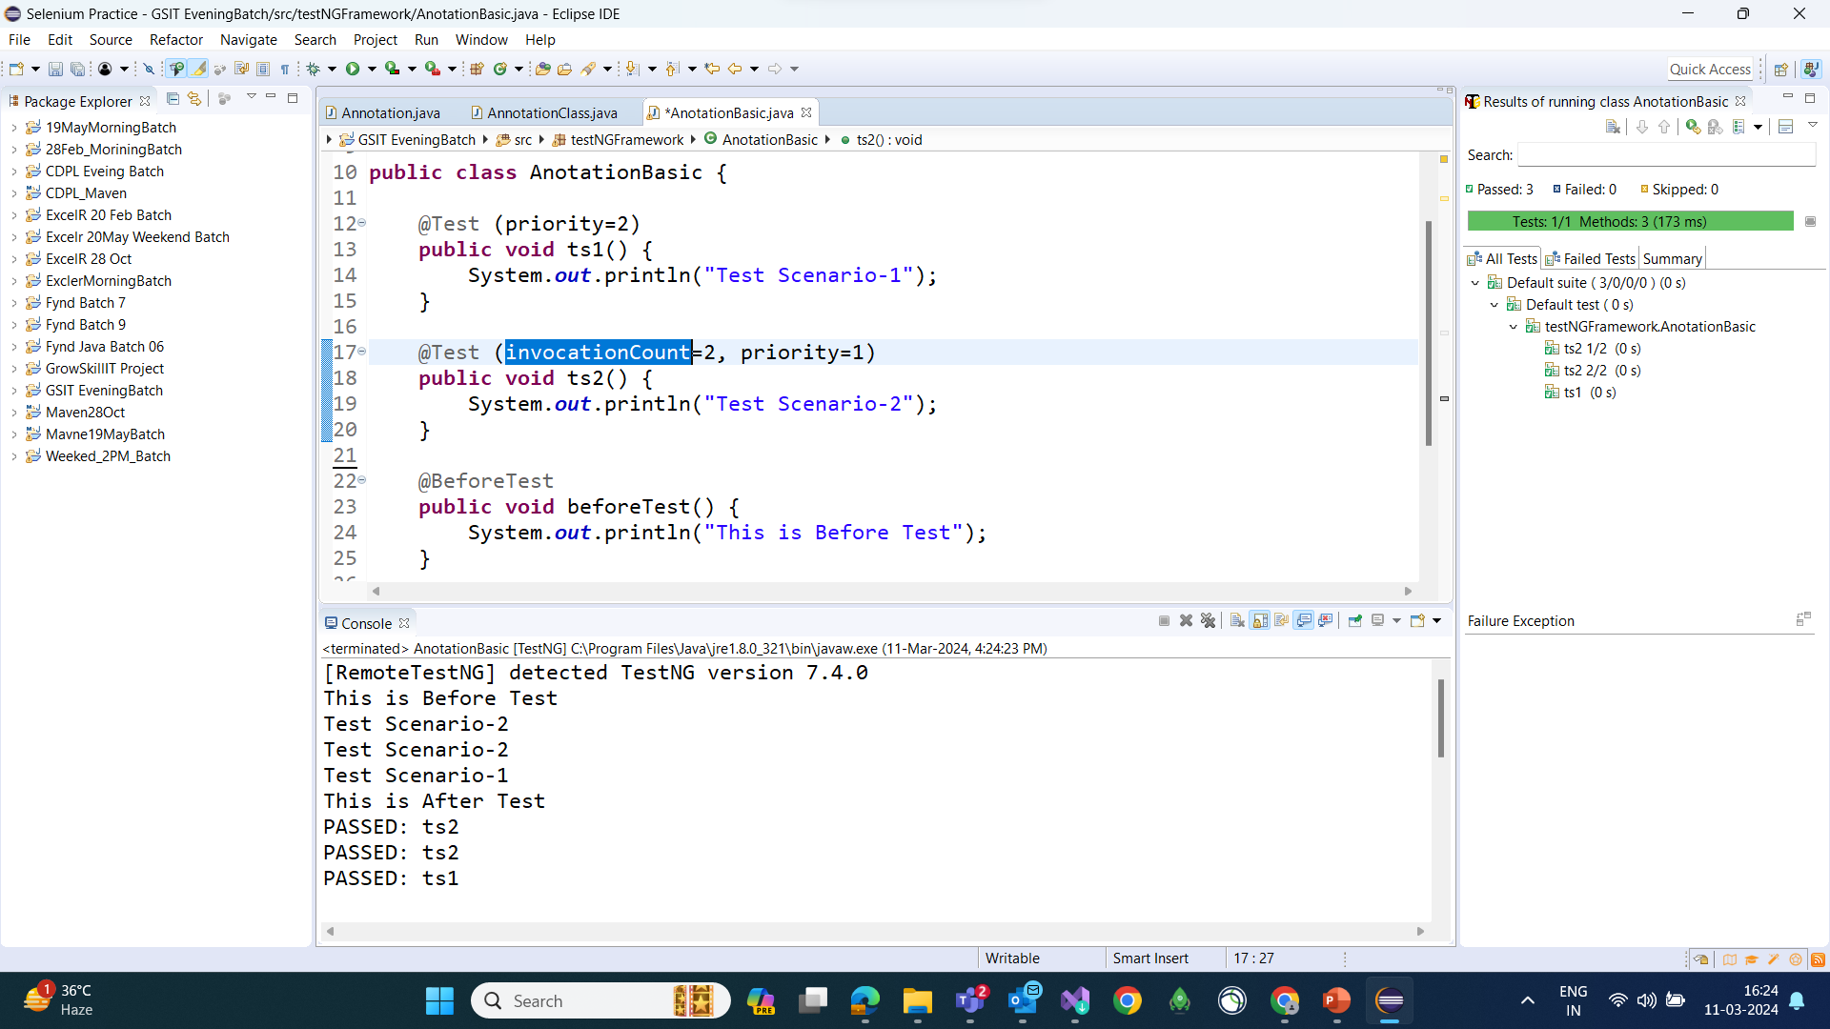
Priority and InvocationCount
invocationCount: The number of times we would like to invoke this method.

Slide 11
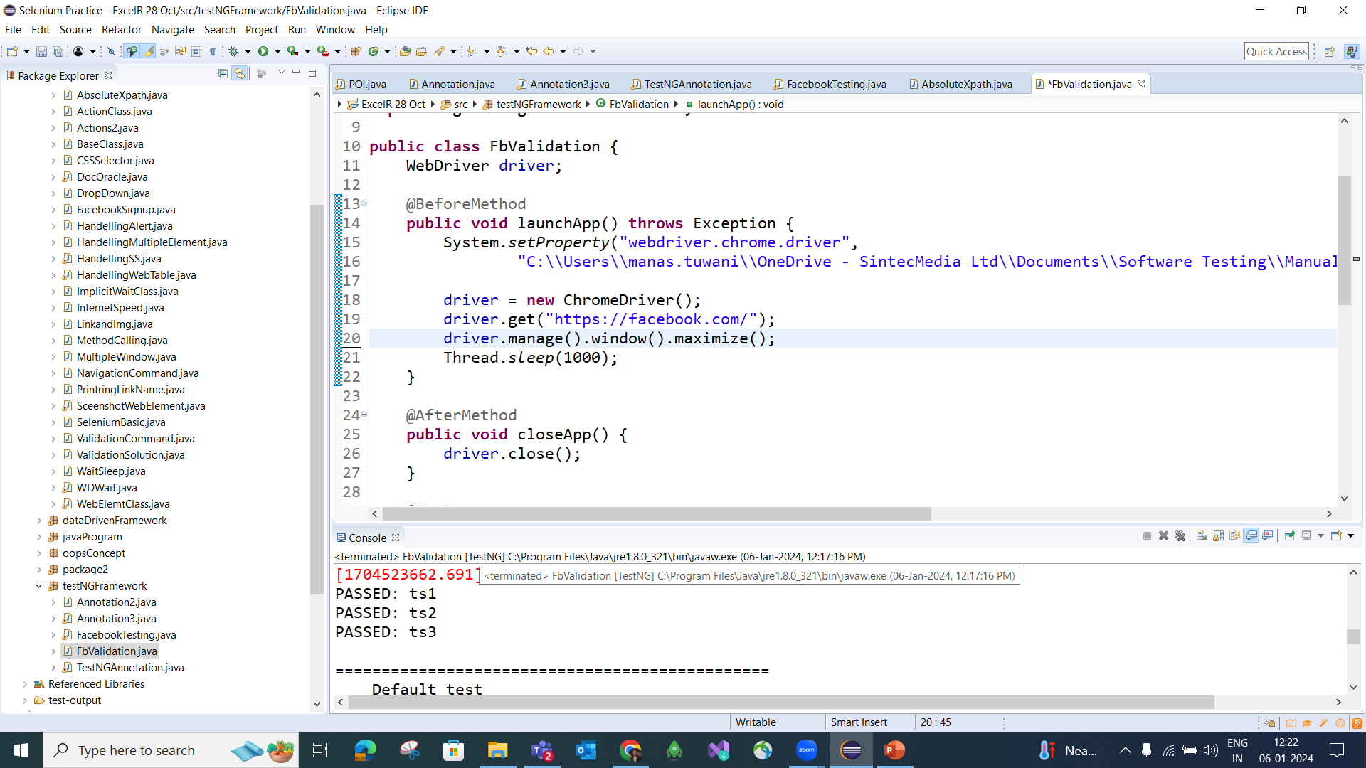

Slide 12
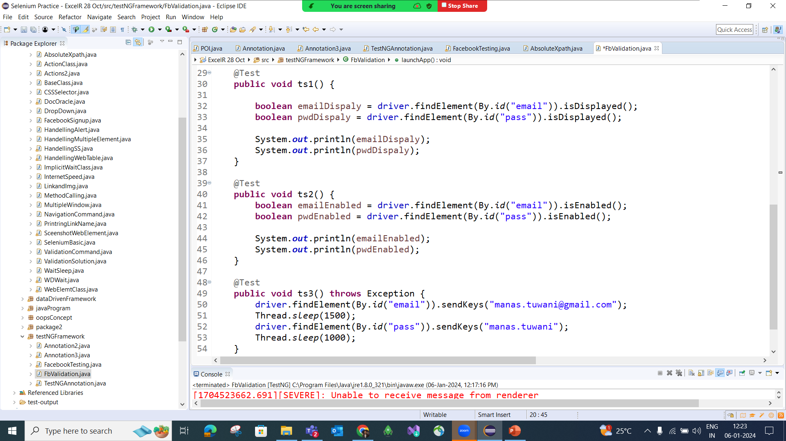

Slide 13
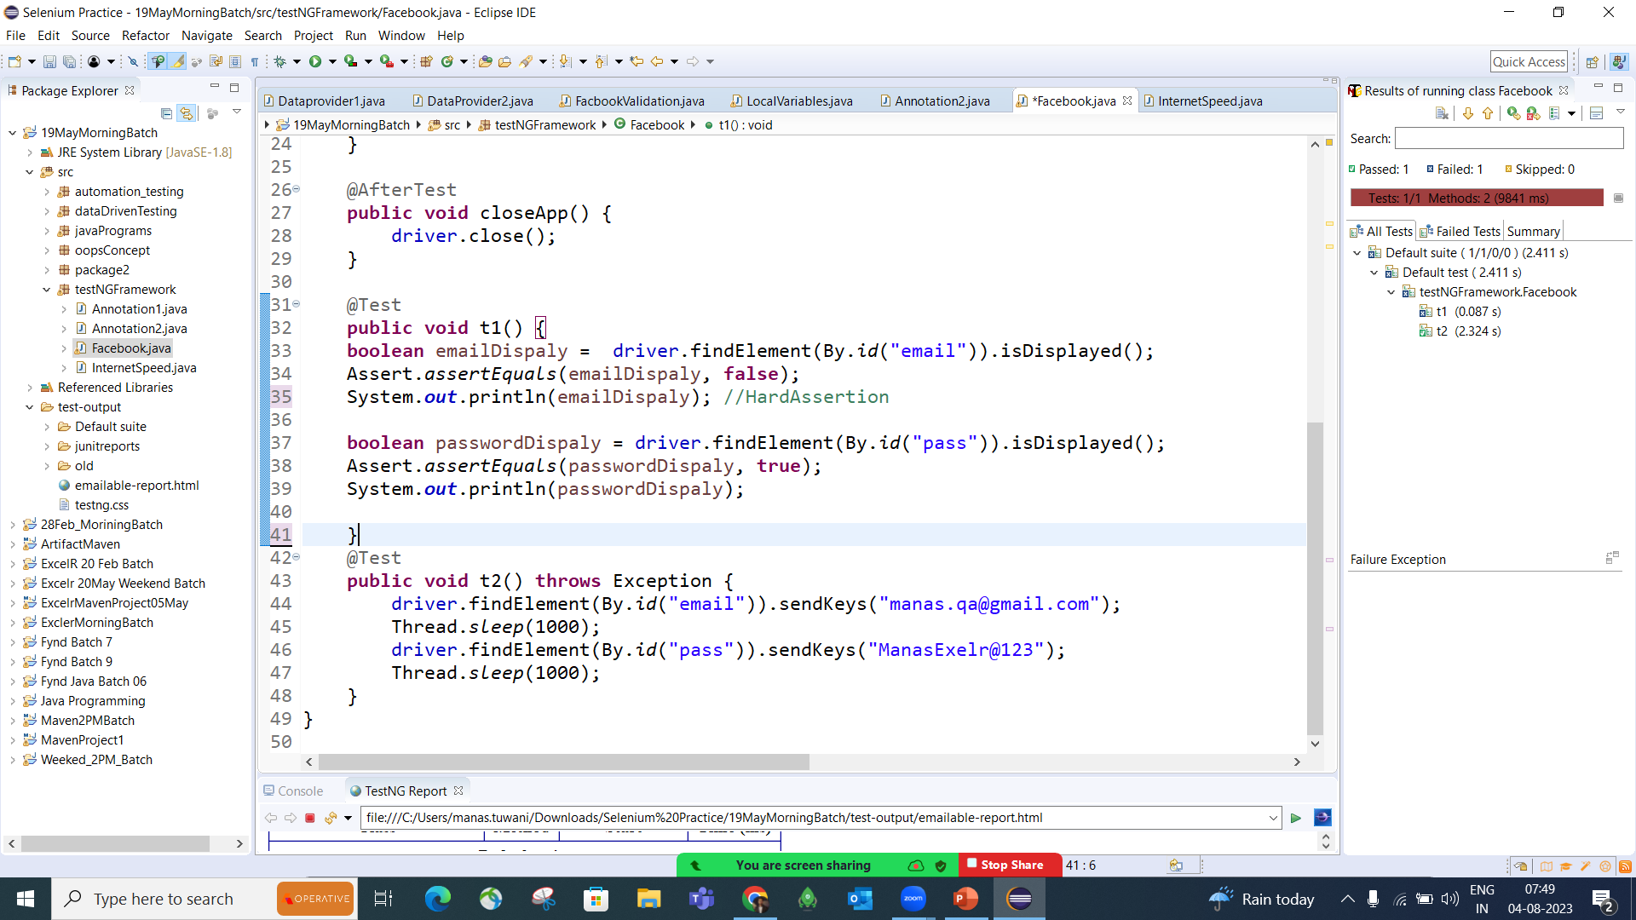

Slide 14
Assertion in TestNg?
In TestNG, an assertions are use for the validation purpose, it is used to verify that the expected result matches the actual result during test execution.
There are two main types of assertions:
Hard Assertion : If a hard assertion fails, the test method stops immediately and marks it as failed.
Soft Assertion : A SoftAssert allows the test to continue even if an assertion fails.

Slide 15
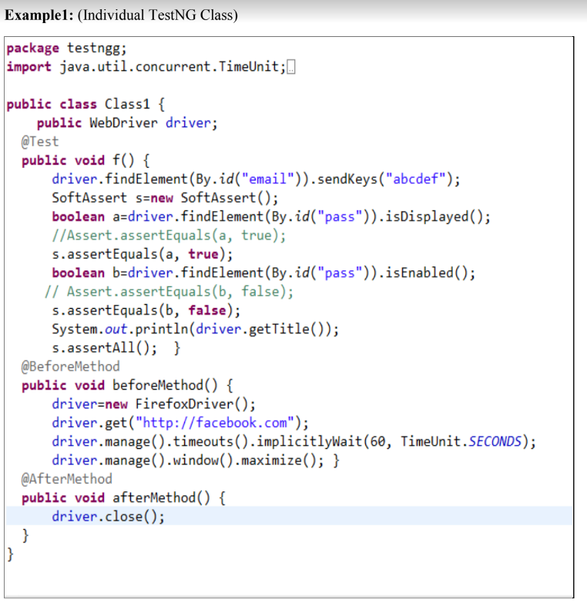

Slide 16
What is soft assert in TestNg?
Soft asserts are the asserts which continue the execution even after the Assert condition fails. Soft asserts are mainly used to verify certain test conditions in the code. It is used in a case when the passing of one test condition is not necessary to execute the upcoming tests
Note:
A SoftAssert allows the test to continue even if an assertion fails.
All results are collected and reported at the end using assertAll().
For working with Soft assert we need to create object of SoftAssert class.
Syntax: SoftAssert obj = new SoftAssert();

Slide 17
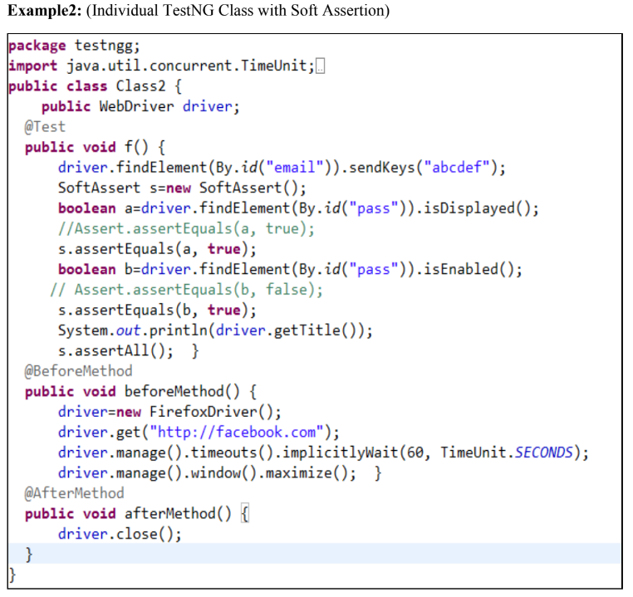

Slide 18
ChromeOption class
ChromeOptions is a class provided by Selenium (in the org.openqa.selenium.chrome package) that allows you to configure and customize the Chrome browser.
For Maximized:
ChromeOptions ref = new ChromeOptions();
ref.addArguments("--start-maximized");
For Incognito Mode:
ChromeOptions ref = new ChromeOptions();
ref.addArguments("--incognito");
For Headless Mode:
ChromeOptions ref = new ChromeOptions();
ref.addArguments("--headless");

Slide 19
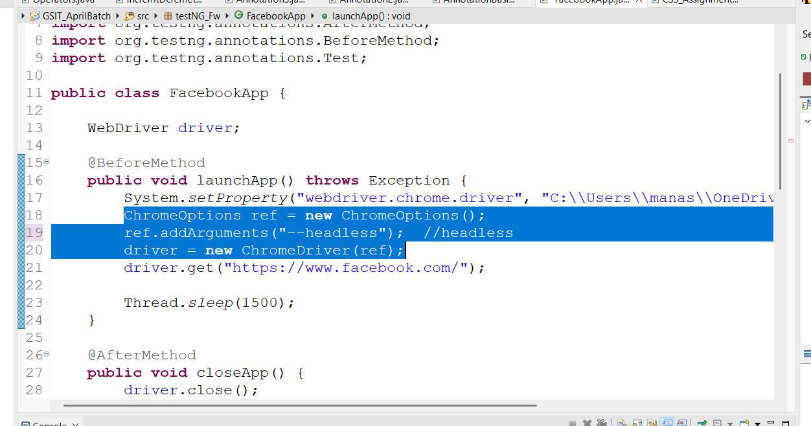

Slide 20
@DataProvider
We are using Dataprovider annotation to pass the multiple data in single testcase
@DataProvider annotation helps us write data-driven test cases. The DataProvider annotation enables us to run a test method multiple times by passing different data-sets.
Syntax: @DataProvider(name = “name of data-provider")
It allows you to run the same test multiple times with different input values, without writing separate test methods.

Slide 21
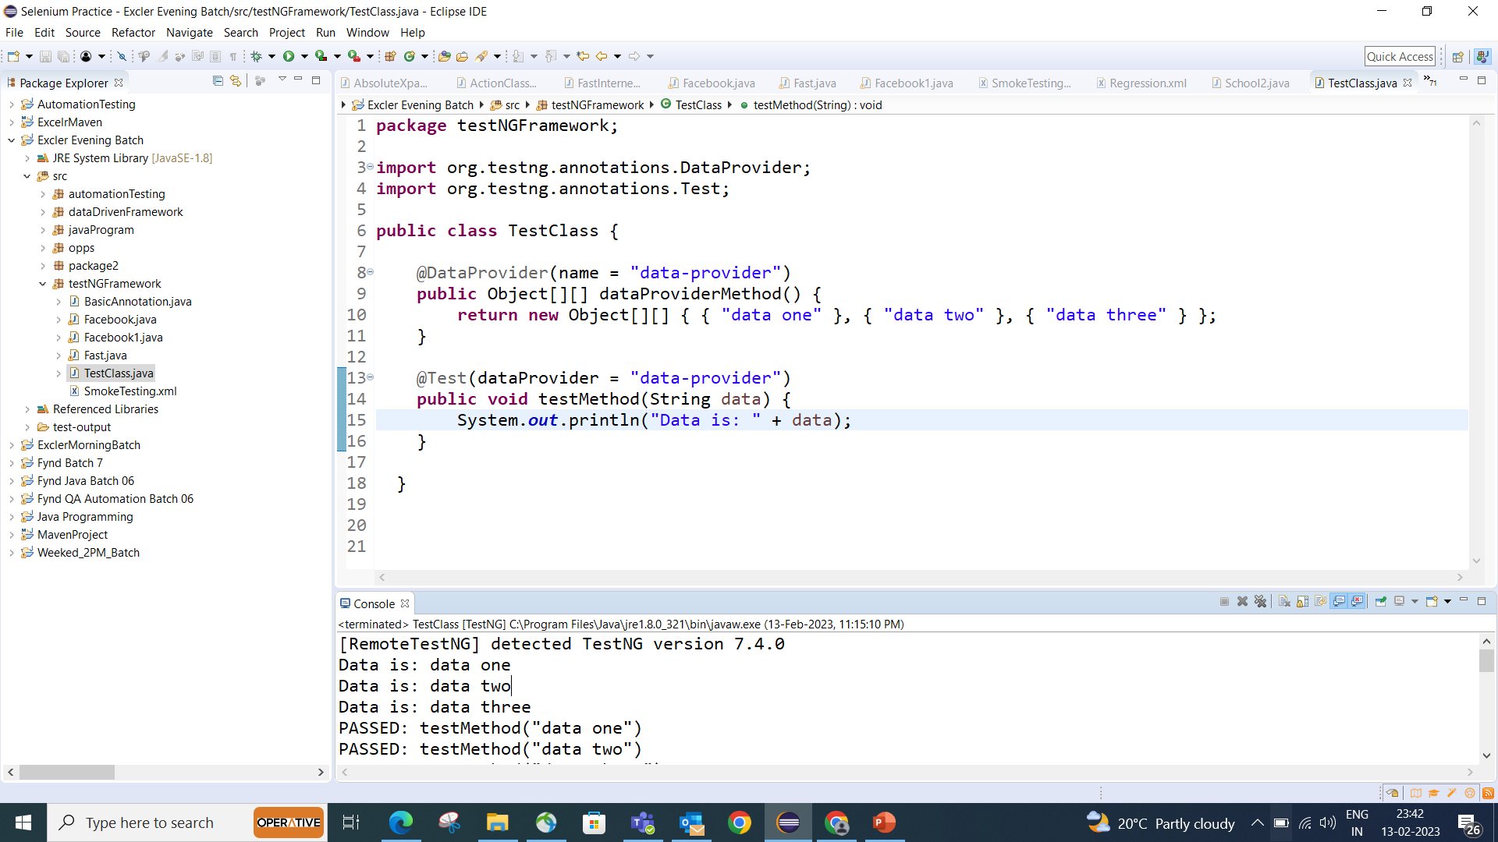

Slide 22
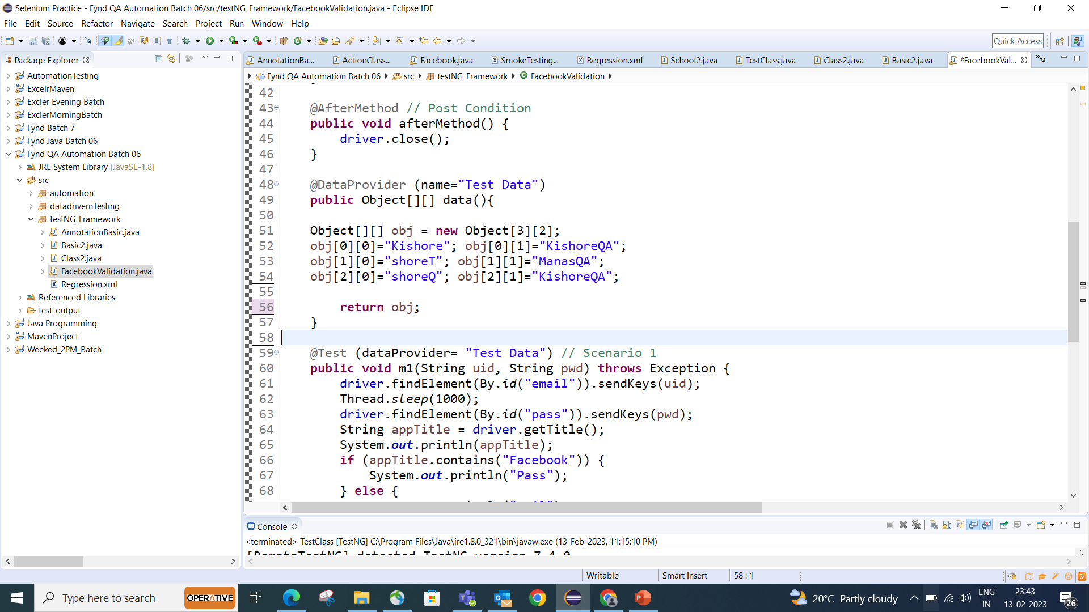

Slide 23
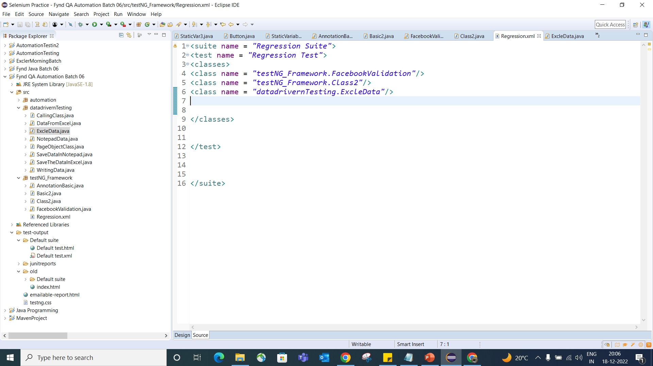
TestNG XML File Navigation to create XML File: Right click on the package -> New -> File -> Specify the name with .xml -> Click on OK -> Click on Source View on XML file -> Prepare the xml program like below

